Slide 1
CPU Scheduling
Contents: Scheduler, Types of Scheduling, Objectives, Life Cycle, Scheduling Parameters, Scheduling Algorithms

Slide 2
What is Process?
A program in execution
An instance of a program running on a computer
The entity that can be assigned to and executed on a processor
A unit of activity characterized by the execution of a sequence of instructions, a current state, and an associated set of system instructions

Slide 3
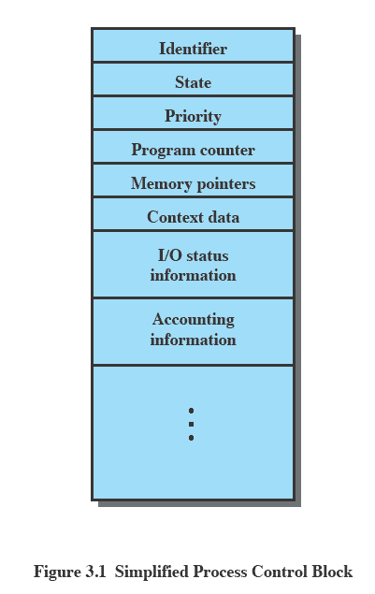
Process Control Block
  Contains the process elements
  Created and manage by the operating system
  Allows support for multiple processes

Slide 4
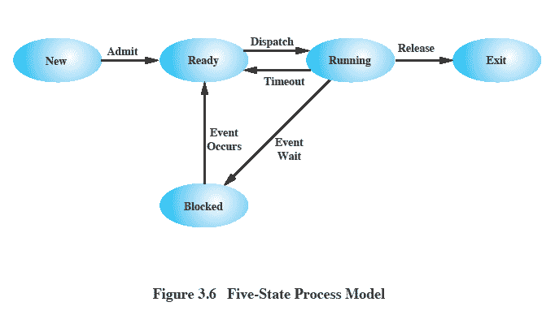
Five States Process Model

Slide 5
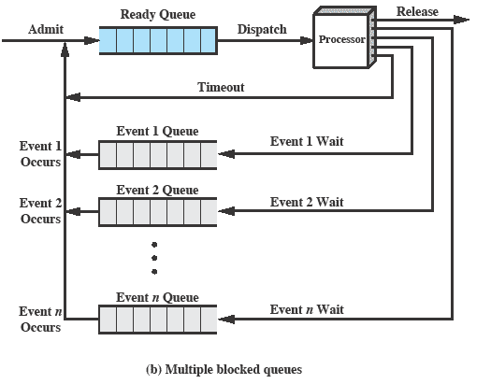
Multiple Blocked Queues

Slide 6
OS Control Structures
Memory Tables
File Tables
IO tables
Process Tables

Slide 7
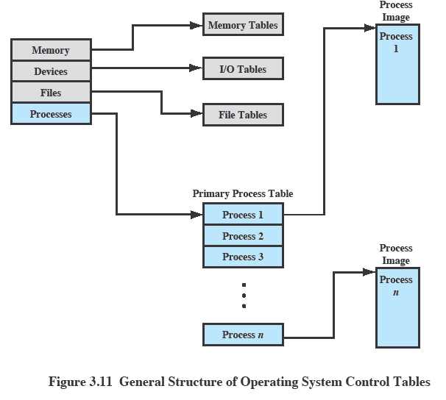
OS Control Tables

Slide 8
CPU Scheduler
  It selects from among the processes in memory that are ready to execute, and allocates the CPU to one of them.
  CPU scheduling decisions may take place when a process:
    Switches from running to waiting state.
    Switches from running to ready state.
    Switches from waiting to ready.
    Terminates.
  Scheduling are of Two Types.
    Preemptive Scheduling
    Non-Preemptive Scheduling

Slide 9
Five States Process Model

Slide 10
Non-preemptive vs. Preemptive
  Non-preemptive
    Once a process is in the running state, it will continue until it terminates or blocks itself for I/O
  Preemptive
    Currently running process may be interrupted and moved to ready state by the OS
    Preemption may occur when new process arrives, on an interrupt, or periodically.

Slide 11
Types of Scheduling
  Long-term scheduling is performed when a new process is created - This is a decision whether to add a new process to the set of processes that are currently active.
  Medium-term scheduling is a part of the swapping function - This is a decision whether to add a process to those that are at least partially in main memory and therefore available for execution.
  Short-term scheduling is the actual decision of which ready process to execute next.

Slide 12
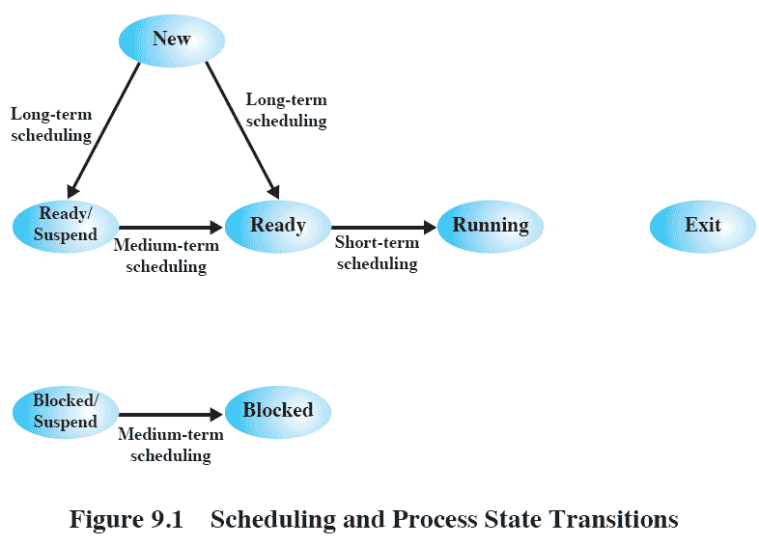
Process State Transitions

Slide 13
Scheduling Parameters
  CPU utilization – keep the CPU as busy as possible
  Throughput – Number of processes that complete their execution per unit time
  Turnaround time – amount of time to execute a particular process. It is summation of Waiting time and execute time.
  Waiting time – amount of time a process spends waiting in the ready queue
  Response time – amount of time it takes from when a request was submitted until the first response is produced, not output.

Slide 14
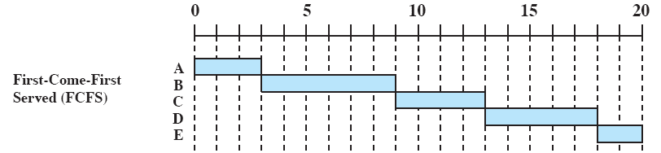
First Come First Served
  Each process joins the Ready queue, When the current process ceases to execute, the longest process in the Ready queue is selected
  A short process may have to wait a very long time before it can execute, Favors CPU-bound processes - I/O processes have to wait until CPU-bound process completes

Slide 15
Shortest Job First
  Associate with each process the length of its next CPU burst. Use these lengths to schedule the process with the shortest time.
  Two schemes:
    nonpreemptive – once CPU given to the process it cannot be preempted until completes its CPU burst.
    preemptive – if a new process arrives with CPU burst length less than remaining time of current executing process, preempt. This scheme is know as the Shortest-Remaining-Time-First (SRTF).
  SJF is optimal – gives minimum average waiting time for a given set of processes.

Slide 16
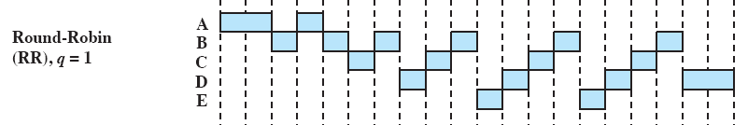
Round Robin
  Uses preemption based on a clock - also known as time slicing, because each process is given a slice of time before being preempted
  Clock interrupt is generated at periodic intervals
  When an interrupt occurs, the currently running process is placed in the ready queue - Next ready job is selected

Slide 17
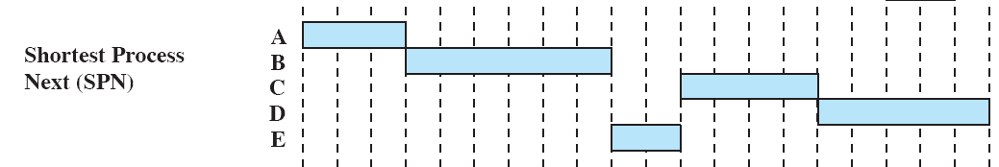
Shortest Process Next
  Non-preemptive policy
  Process with shortest expected processing time is selected next
  Short process jumps ahead of longer processes

Slide 18
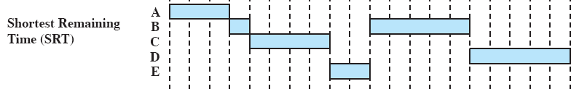
Shortest Remaining Time
  Preemptive version of shortest process next policy
  Must estimate processing time and choose the shortest

Slide 19
Priority Scheduling
  The priority number (integer) is associated with each process
    The CPU is allocated to the process with the highest priority (smallest integer ≡ highest priority).
    Preemptive vs nonpreemptive
  SJF is a priority scheduling where priority is the predicted next CPU burst time.
  Problem is Starvation – low priority processes may never execute. Solution is aging – as time progresses increase the priority of the process.

Slide 20
Problems (1)
Process | Burst Time
P1 | 24
P2 | 3
P3 | 3
  Scheduling Policy - FCFS
  Calculate the average waiting time when the processes arrive in the following order :
  (a) P1, P2, P3
  (b) P2, P3, P1: AVG WAITING TIME
  (a) 3
  (b) 2
  (c) 1
  (d) 5

Slide 21
Problems (2)
Process | Burst Time
P1 | 3
P2 | 6
P3 | 4
P4 | 2
  Schduling Policy – SJF (non-preemptive)
  Calculate the average waiting time and average turnaround time when the processes arrive in the following order :
  (a) P1, P2, P3, P4

Slide 22
Problems (3)
Process | Burst Time | Priority
P1 | 3 | 2
P2 | 6 | 4
P3 | 4 | 1
P4 | 2 | 3
  Schduling Policy – Priority Scheduling
  Calculate the average waiting time and average turnaround time when the processes arrive in the following order :
  (a) P1, P2, P3, P4

Slide 23
Problems (4)
Process | Burst Time
P1 | 3
P2 | 6
P3 | 4
P4 | 2
  Schduling Policy – Round Robin Scheduling (2ms)
  Calculate the average waiting time

Slide 24
Problems (5)
Process | Burst Time | Priority
P1 | 10 | 3
P2 | 1 | 1
P3 | 2 | 3
P4 | 1 | 4
P5 | 5 | 2
  Schduling Policy – FCFS, SJF-Preemptive, SJF-Non Preemptive, RR (Quantum = 1)
  Calculate the average waiting time
  Calculate Turnaround Time

Slide 25
Problems (6)
Process | Arrival Time | Burst Time
P1 | 0 | 8
P2 | 1 | 4
P3 | 2 | 9
P4 | 3 | 5
  Schduling Policy – FCFS, SJF-Preemptive, RR (Quantum = 1)
  Calculate the average waiting time
  Calculate Turnaround Time

